Slide 1

Customer Churn
Data cleaning to Karma 360
Peter Huang
Moo-Fon Lee
Dataset URL
Notes:
1

Slide 2
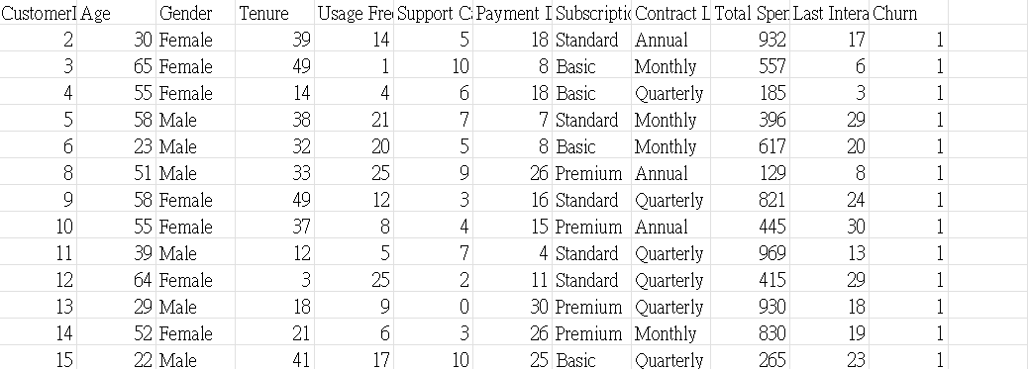
Original Dataset (450000 rows and 12 columns)
This data tracks the customer churn rate, indicating whether customers stop using the company's products or services within a specific period.
No missing values
Notes:
3

Slide 3
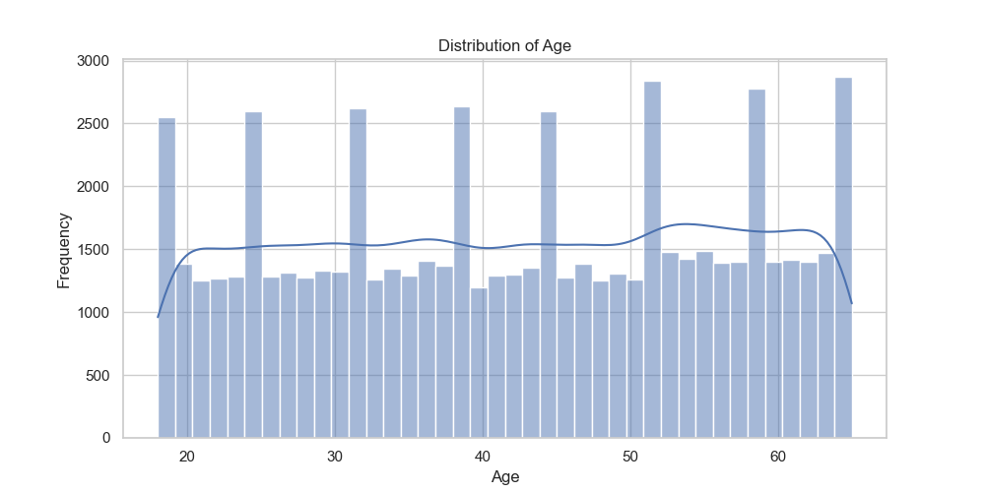
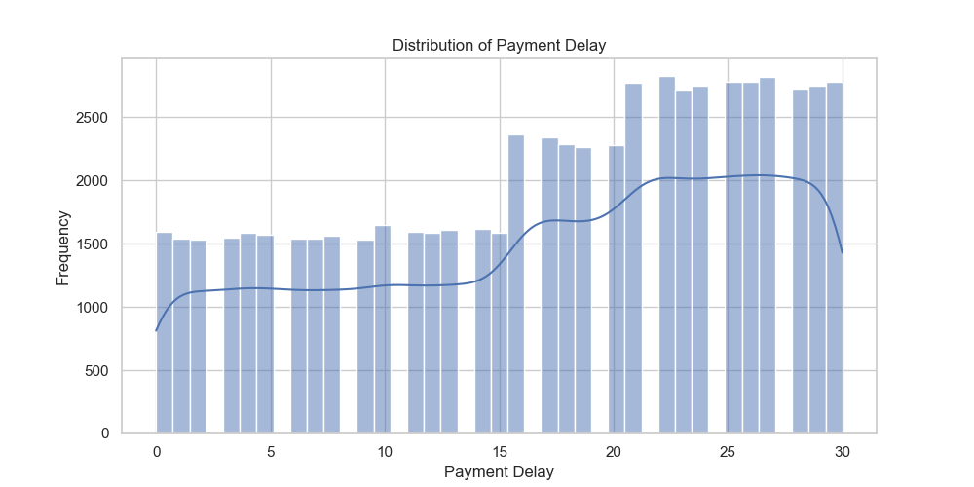
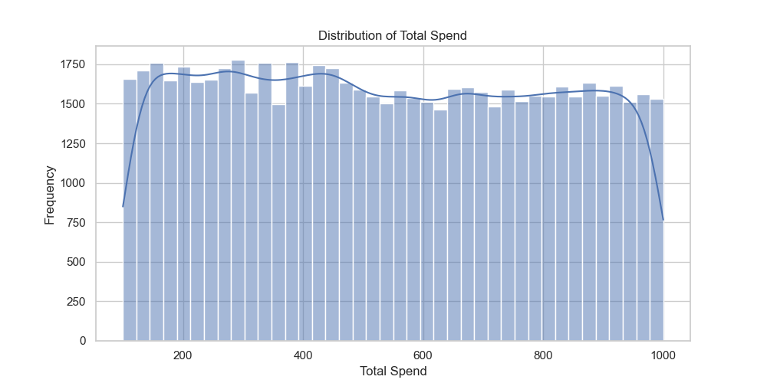
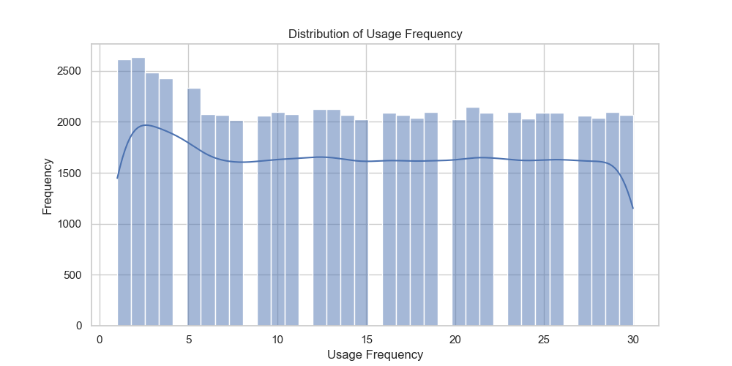
Distribution(take 60000 rows)
Age
Payment Delay
Total Spend
Usage Frequency
Notes:
3

Slide 4
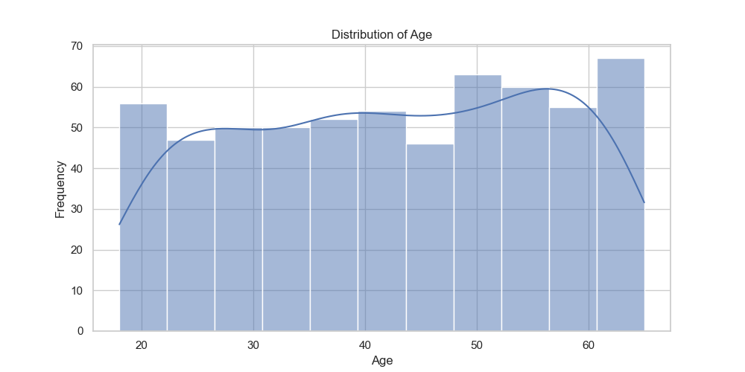
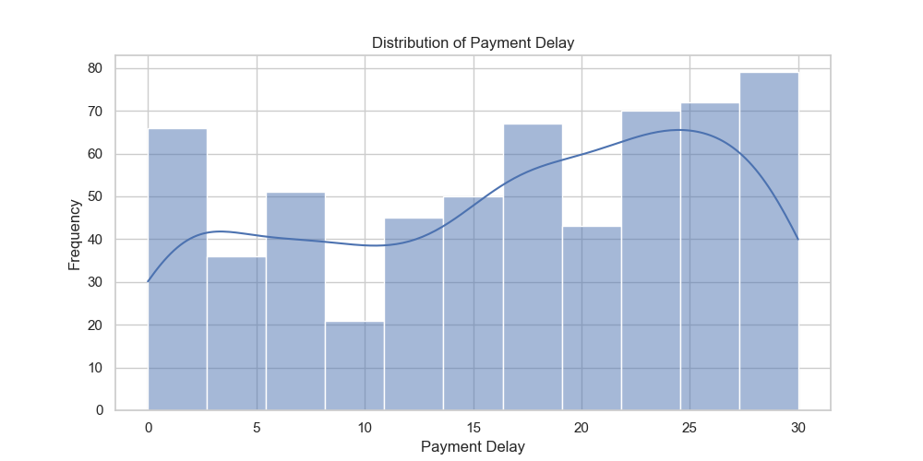
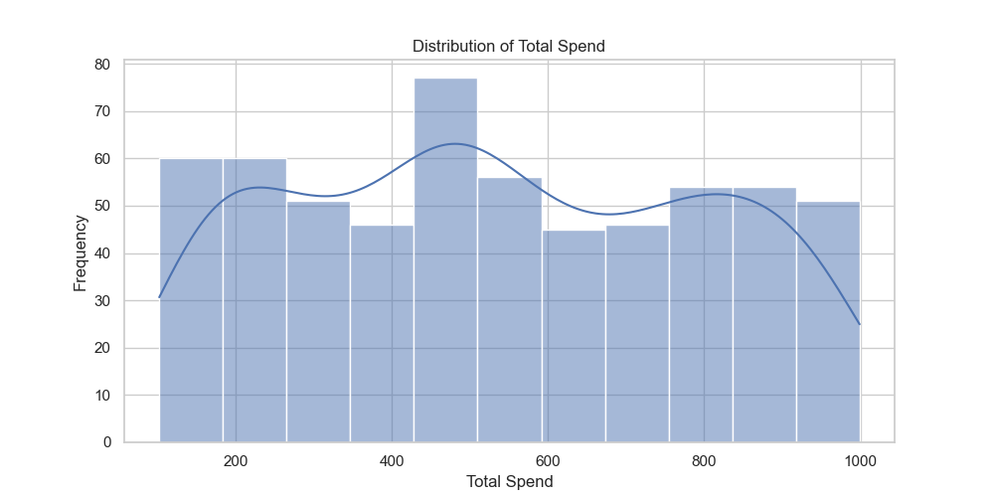
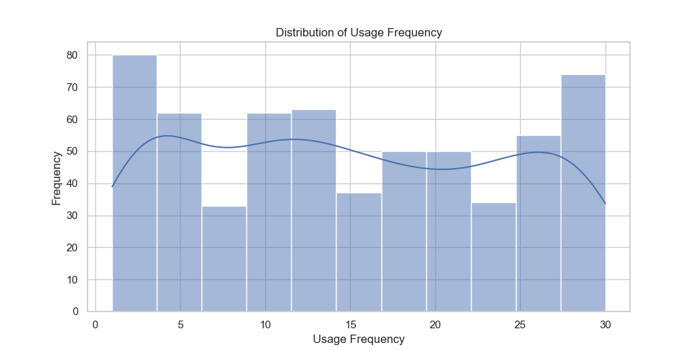
Distribution(take 600 rows)
Age
Payment Delay
Total Spend
Usage Frequency
Notes:
3

Slide 5
Data Cleaning
Encoding
1
1. One-Hot Encoding(imply 2 column, append 4 more column)
2. Ordinal Encoding(imply 2 column to numeric value 0,1,2)
Outliers
2
Use Q1 Q3 to judge outliers(No outliers)
Other
3
Randomly delete data to balance the target column "Churn".
2. Drop ID column
Notes:
3

Slide 6
Size Compare
Notes:
3

Slide 7
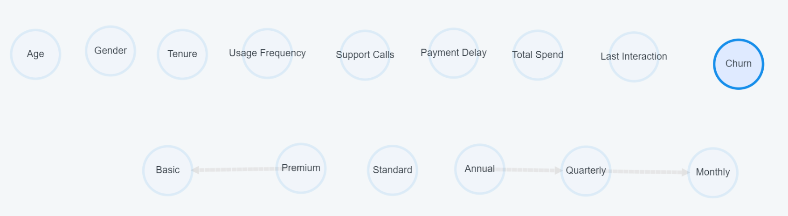
One-Hot vs Ordinal Encoding
Subscribtion Type→ Premium, Standard, Basic
Contract Length→ Monthly, Quarterly, Annual
One-Hot Encoding
Notes:
3

Slide 8
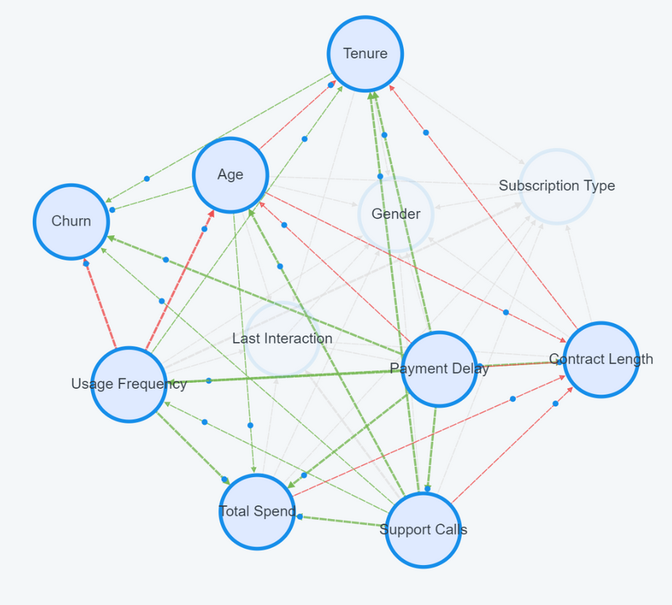
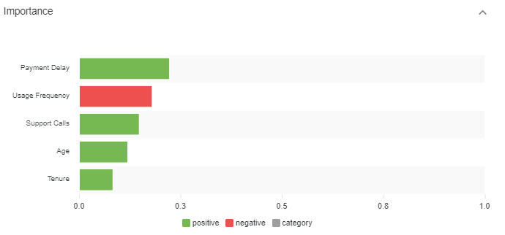
One-Hot vs Ordinal Encoding
Payment Delay: 0.223
Usage Frequency: -0.18
Support Calls: 0.148
Age: 0.12
Tenure: 0.083
Ordinal Encoding
Notes:
3

Slide 9
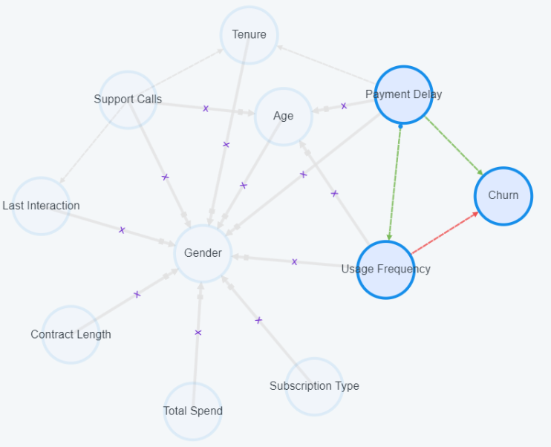
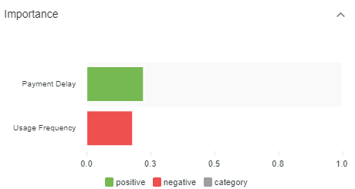
Imply Prior Knowledge
(There’s no factor that can change "age" and "gender")
Payment Delay: 0.223
Usage Frequency: -0.18
Notes:
3

Slide 10
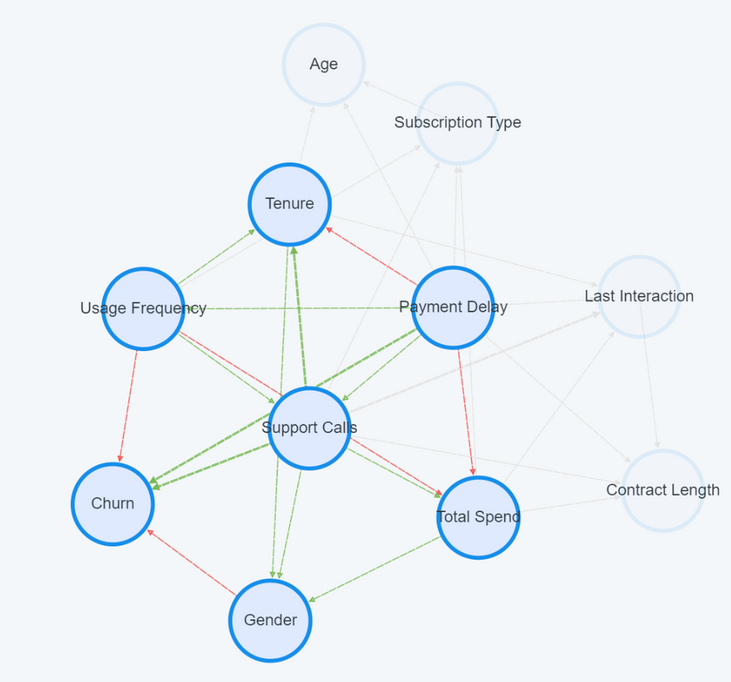
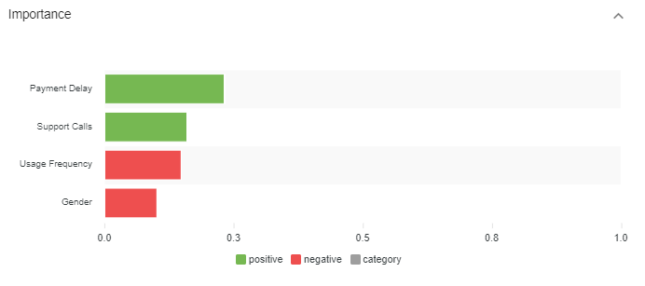
Payment Delay: 0.232
Support Calls: 0.159
Usage Frequency: 0.148
Gender: 0.101
Ordinal Encoding(Gender:Int)
Notes:
3

Slide 11
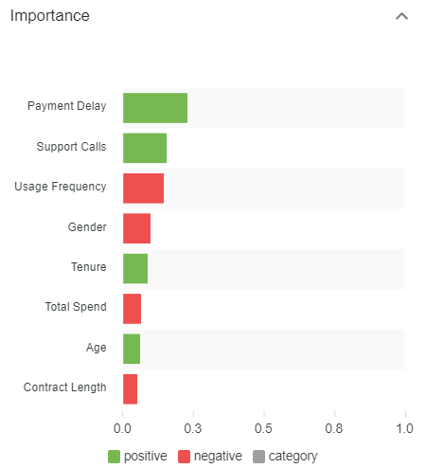
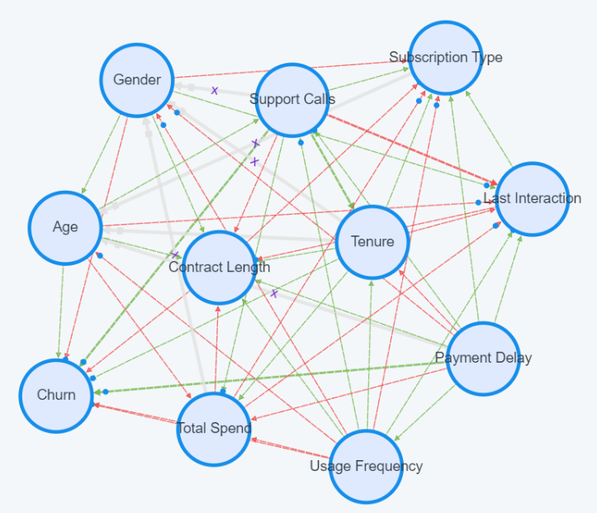
Imply Prior Knowledge
Payment Delay: 0.232
Support Calls: 0.159
Usage Frequency: 0.148
Total Spend 0.101
Tenure: 0.091
Gender: 0.067
Age: 0.065
Contract Length: 0.054
Ordinal Encoding(Gender:Int)
Notes:
3

Slide 12
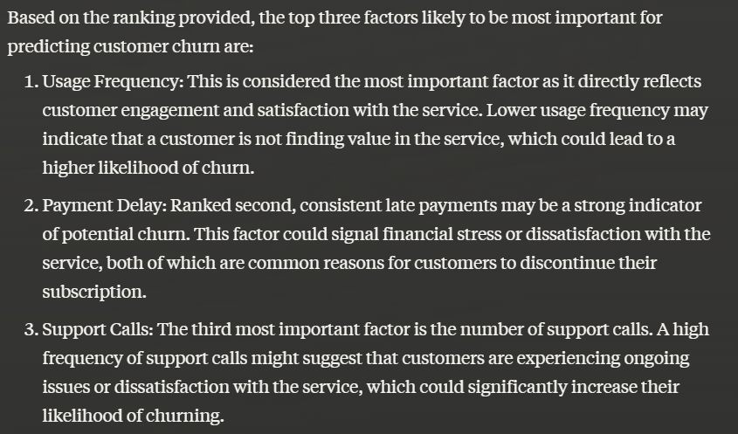
(Sort by Importance)
Operate with LLM
First Three Factor is Same
Notes:
3

Slide 13
Conclusion
1. If a factor has hierarchical levels (ex. month, quarter, annual), using Ordinal Encoding(turn category into number) or another method would be more effective.
2. In binary data (ex. gender), using categorical data will have a better results than using numeric data.
Notes:
3

Slide 14
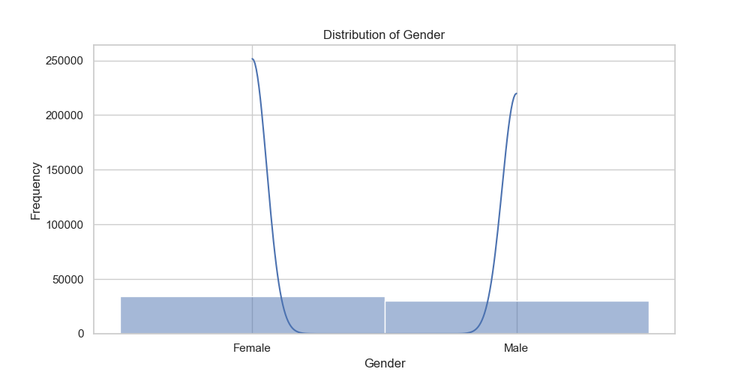
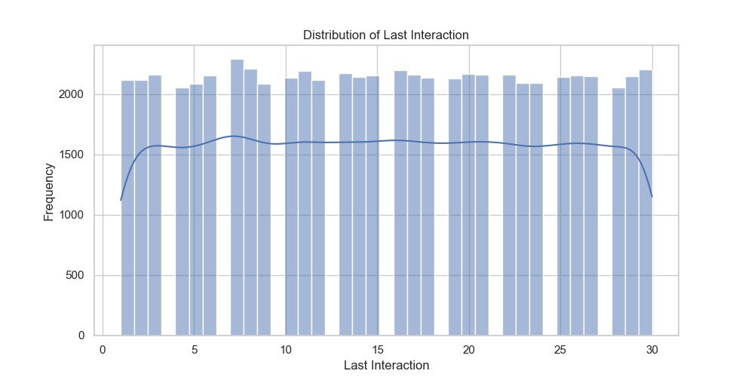
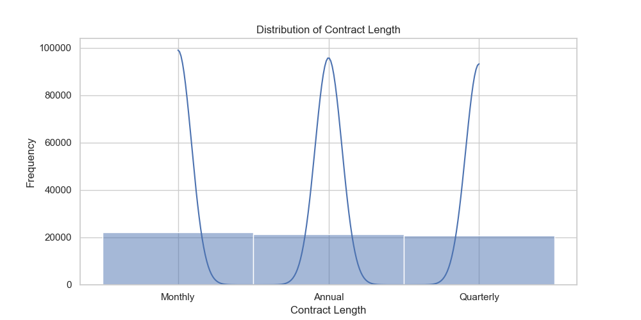
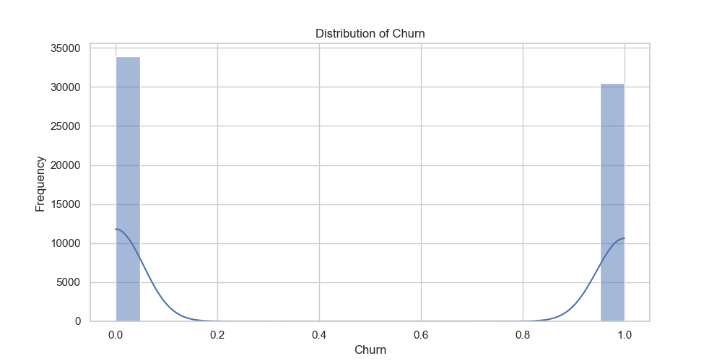
Appedix: Other Distribution(60000 rows)
Notes:
3

Slide 15
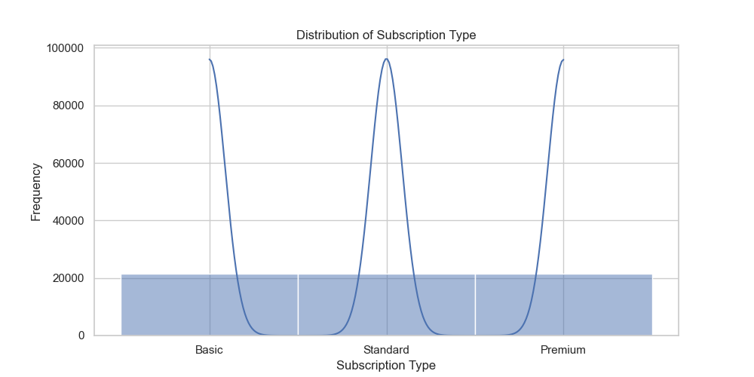
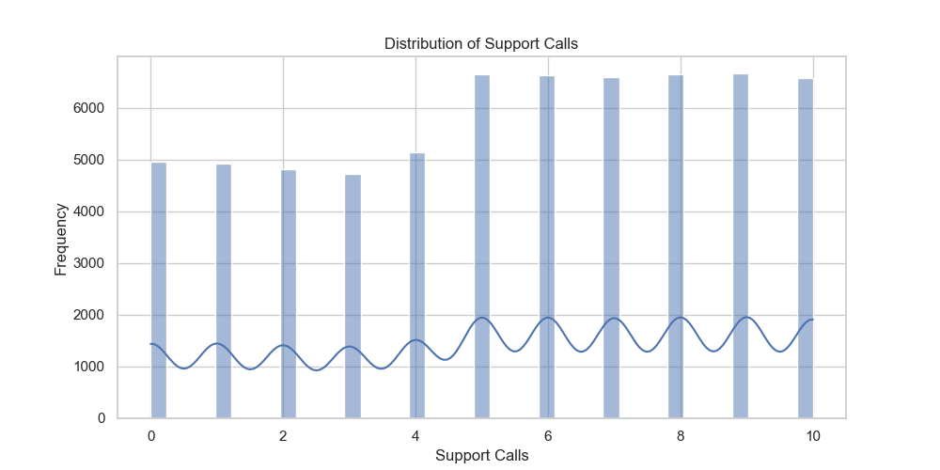
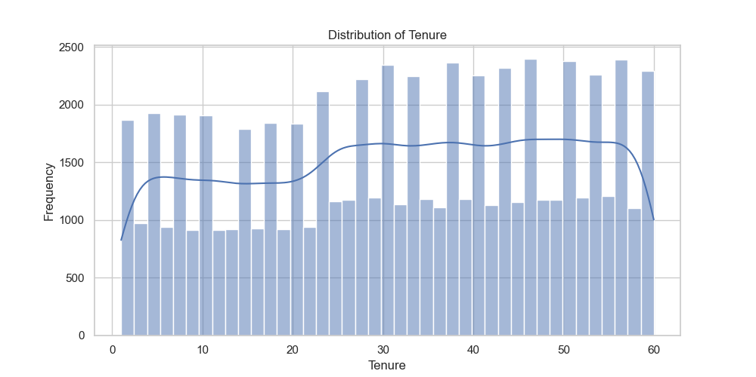
Notes:
3

Slide 16
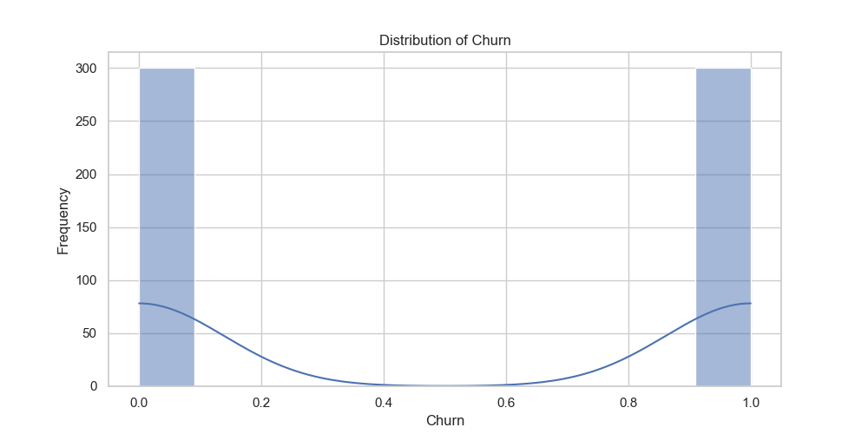
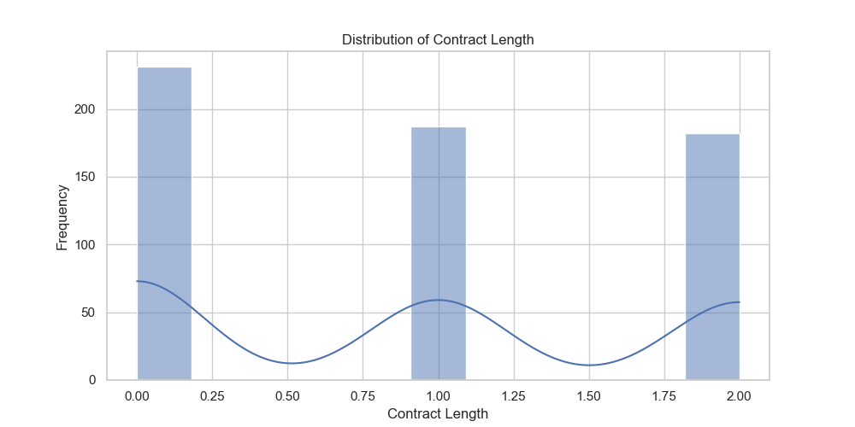
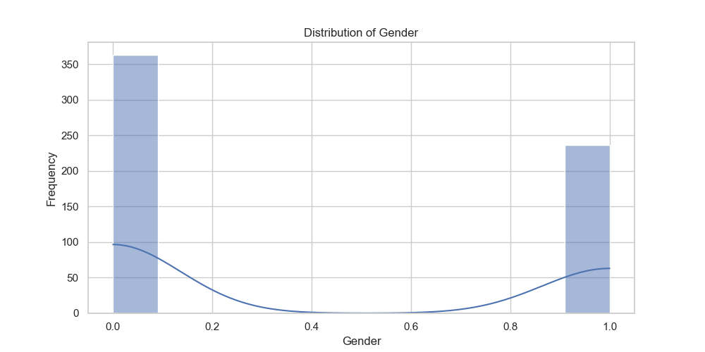
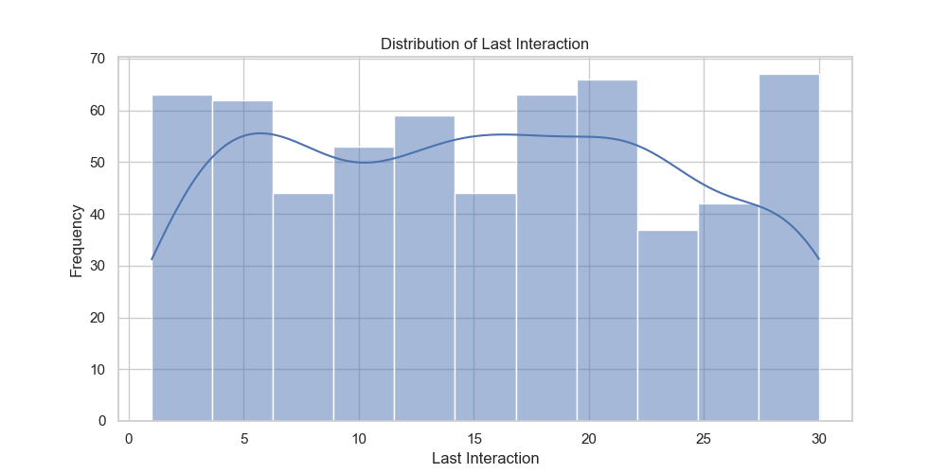
Appedix: Other Distribution(600 rows)
Notes:
3

Slide 17
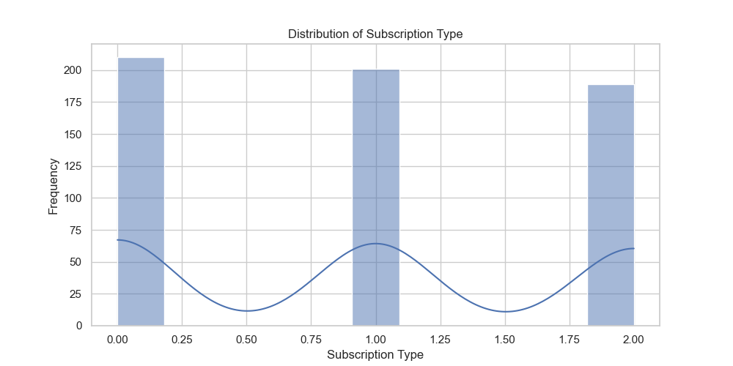
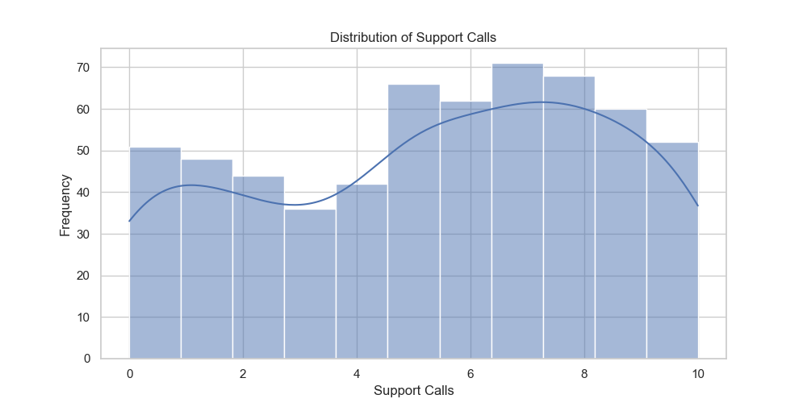
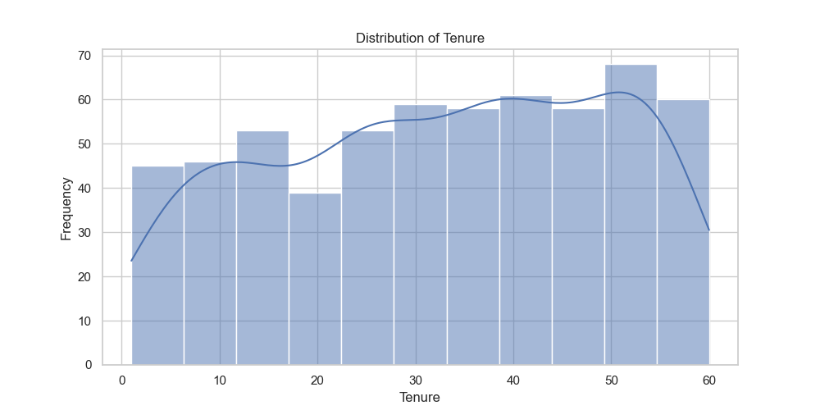
Notes:
3

